Slide 1
UI & UX Design
User Interface & User Experience Essentials

Slide 2
What is UI (User Interface)?
UI is the visual and interactive elements that users see and interact with:
UI Example
• Buttons, menus, icons, typography
Login Button
• Layout, colors, spacing, and visual hierarchy
Input Field
• Forms, navigation, and controls
• Animations and transitions
Checkbox
Remember me

Slide 3
What is UX (User Experience)?
UX is the overall experience a user has when interacting with a product:
• User research and understanding needs
• Information architecture and flow
• Accessibility and usability
• Performance and reliability
User Journey Example:
1
2
3
4
5
Visit
Browse
Select
Checkout
Confirm

Slide 4
UI vs UX: Key Differences
UI Design
UX Design
→ Focuses on look & feel
→ Focuses on experience
→ Visual design elements
→ User research & testing
→ Aesthetic choices
→ Problem solving
→ Interaction design
→ Accessibility
→ Responsive layouts
→ User satisfaction

Slide 5
Case Study: E-Commerce Platform
UI Improvements
UX Improvements
✓ Modern button design
✓ Faster checkout (3 clicks)
✓ High-contrast colors
✓ Mobile-first approach
✓ Consistent iconography
✓ One-click payment
✓ Clean product grid
✓ Clear product info
✓ Smooth transitions
✓ Easy returns process
Result: 45% increase in conversions, 3x user satisfaction improvement

Slide 6
UI Design Best Practices
1
Consistency
Use same colors, fonts, and spacing throughout
2
Hierarchy
Make important elements visually prominent
3
Whitespace
Don't overcrowd—let content breathe
4
Accessibility
Ensure enough contrast and readable fonts
5
Responsiveness
Adapt beautifully to all screen sizes

Slide 7
UX Design Best Practices
1
User Research
Understand your users' needs and pain points
2
Simplicity
Remove unnecessary steps and complexity
3
Feedback
Provide clear confirmation for user actions
4
Testing
Regularly test with real users and iterate
5
Performance
Make apps fast—slow experiences frustrate users

Slide 8
The Design Process
1
2
3
4
5
→
→
→
→
Discover
Define
Design
Test
Iterate
Research users & market
Clarify goals & problems
Create wireframes & mockups
Validate with users
Improve based on feedback

Slide 9
Tools for UI/UX Design
Design Tools
Research & Testing Tools
• Figma
• UserTesting
• Adobe XD
• Hotjar
• Sketch
• Maze
• Webflow
• Optimal Workshop

Slide 10
Great UI + Great UX =
Happy Users & Successful Products
Remember: Design is not just about aesthetics—it's about solving real problems for real people.
Questions?

Slide 11
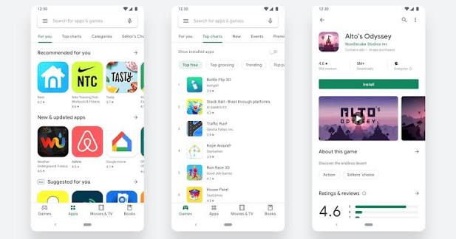
1. Play store APP
UI and UX of play store
🎨 UI: The “Install” button is green, rounded, and clearly visible.
👍 UX: You can find an app quickly, understand what it does, tap Install, and easily see the download progress.
So, UI = how it looks; UX = how it works/feels.

Slide 12
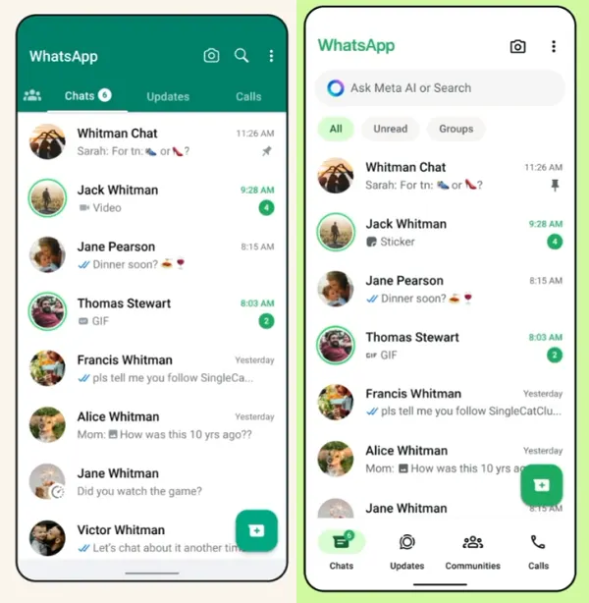
2 . WhatsApp APP
UI and UX of WhatsApp
UI (User Interface) = how WhatsApp looks.
Chat screen layout
Colors and icons
Fonts and buttons
Profile pictures
Call and chat tabs
Message bubbles
UX (User Experience) = how WhatsApp feels and works when you use it.
How easily you can send a message
How quickly you can find a chat
How simple it is to make a voice/video call
How smoothly you can share photos or documents
Whether notifications and navigation are intuitive
Simple example:
The green Send button is UI.
Being able to quickly find and press it to send a message is UX.

Slide 13
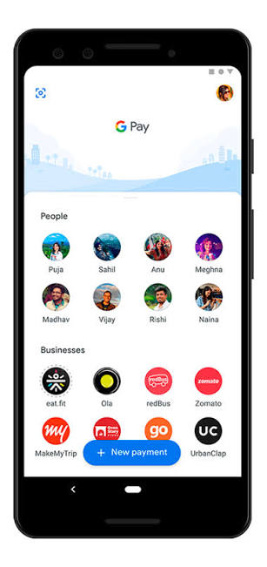
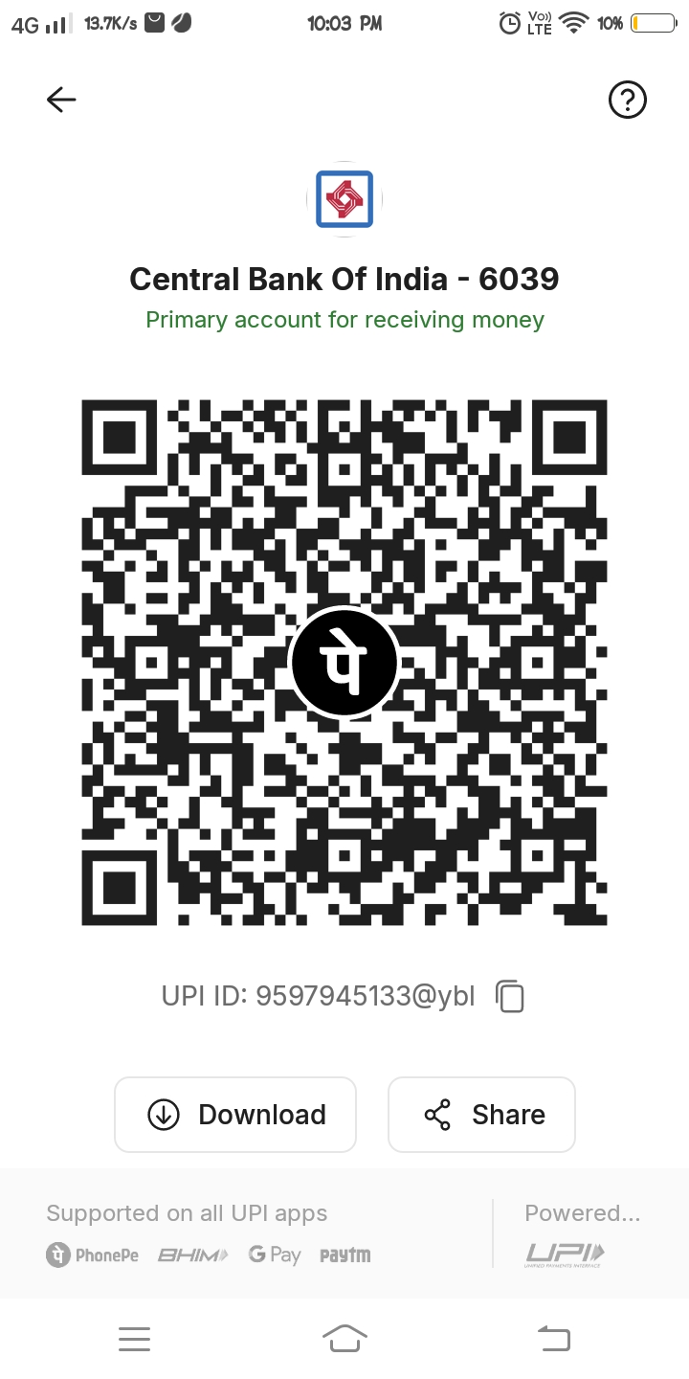
3. Google pay app
UI and UX of Google pay
Google Pay UI :
UI means what you see on the screen.
Examples:
Google Pay logo and colors
Pay anyone button
QR scanner icon
Send/Request money buttons
Bank account and balance sections
Transaction history
Icons, fonts, cards, and menus
Layout of the home screen
Google Pay UX :
UX means how easy and convenient it is to use Google Pay.
Examples:
How easily you can find a person and send money
How quickly you can scan a QR code
How simple the payment process is
Clear confirmation after payment
Easy access to transaction history
Helpful error messages when a payment fails
How confidently and smoothly a user completes a payment
Simple example
UI: The QR-code scanner button is clearly visible on the home screen.
UX: Because the scanner is easy to find, the user can quickly scan a shop's QR code and complete the payment without confusion.

Slide 14
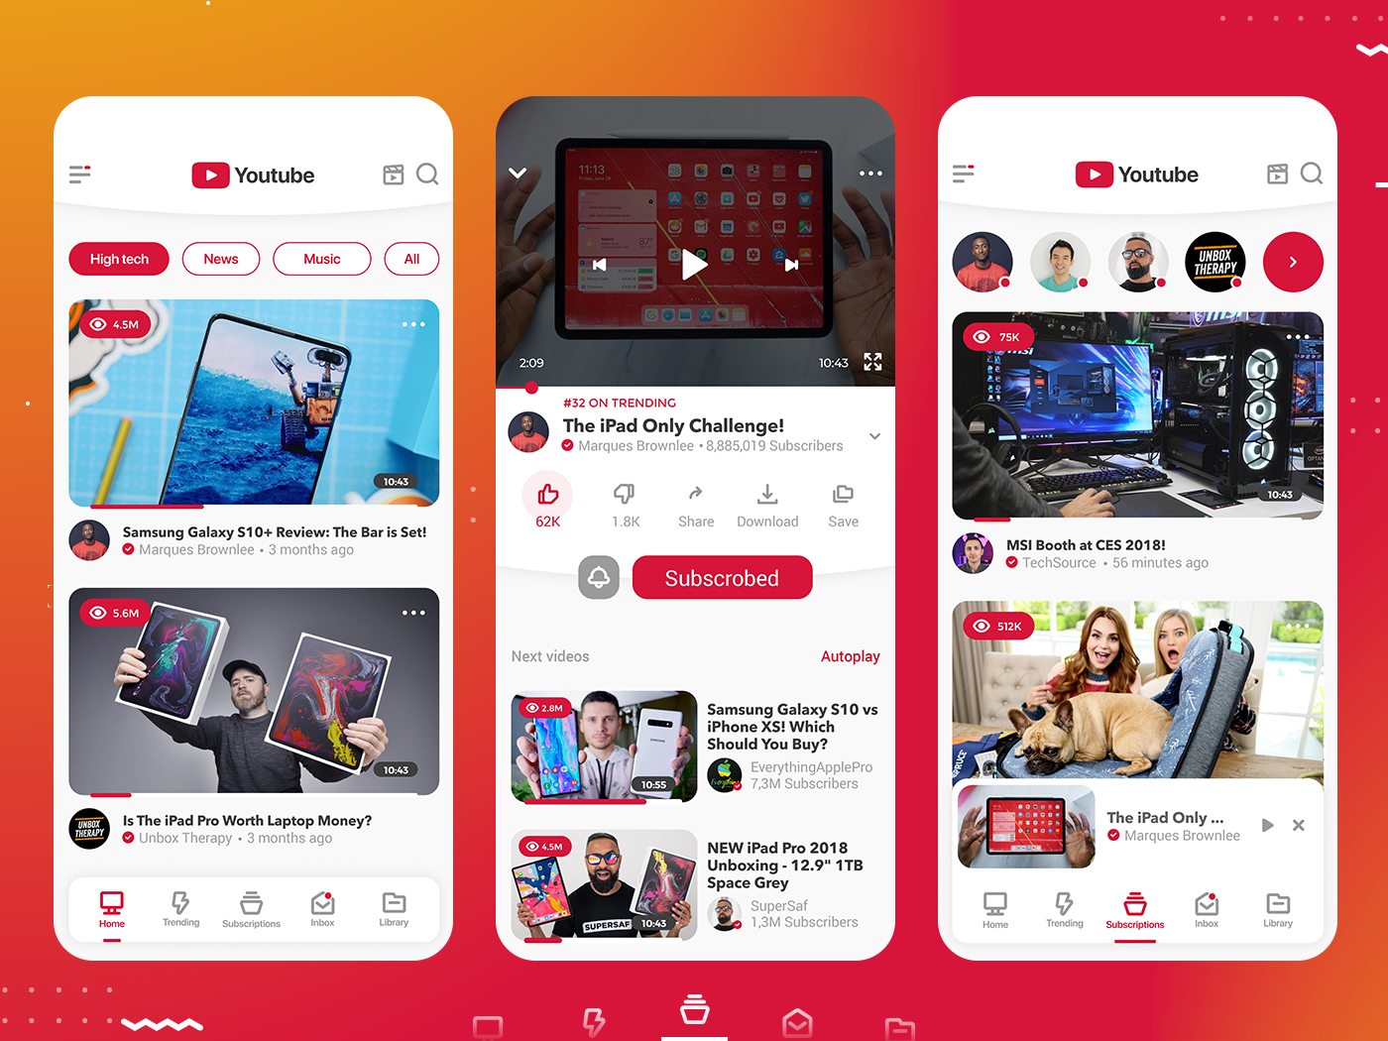
4. YOUTUBE
UI and UX of YouTube
YouTube UI — User Interface :
UI is what you see and interact with.
Examples:
YouTube logo
Search bar
Subscribe button
Like, dislike, and share icons
Video thumbnails
Play/pause buttons
Comments section
Home, Shorts, Subscriptions buttons
Colors, fonts, icons, and page layout.
YouTube UX — User Experience :
UX is how easy and enjoyable YouTube is to use.
Examples:
Finding a video quickly using search
Getting useful video recommendations
Easily subscribing to a channel
Watching videos without confusion
Quickly adjusting video quality or playback speed
Finding and reading comments easily
Moving smoothly between Home, Shorts, and Subscriptions
Getting relevant recommendations based on viewing history.
Simple example:
UI: YouTube has a red Subscribe button below a video.
UX: The button is easy to find and subscribe with one tap, making the experience simple.

Slide 15
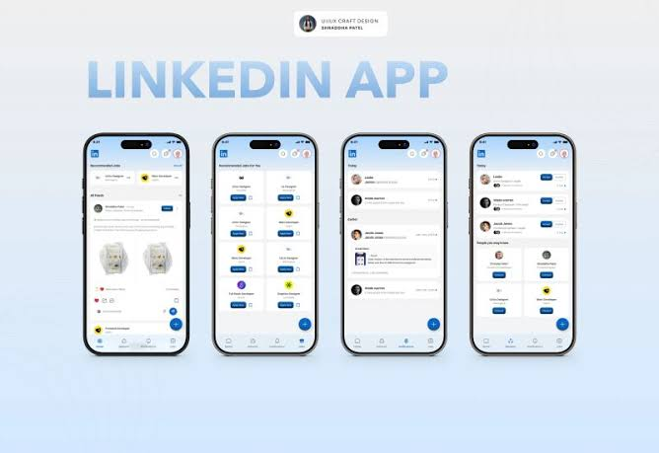
5. LINKEDIN APP
UI and UX of LINKEDIN
UI (User Interface) = What LinkedIn looks like.
  Buttons
  Colors
  Fonts
  Icons
  Profile layout
  Navigation bar
UX (User Experience) = How LinkedIn works and feels when you use it.
  How easy it is to create a profile
  How simple it is to find jobs
  How easily you can connect with people
  How smooth the messaging experience is
  How quickly you can find posts or information
Simple example:
LinkedIn's “Connect” button design → UI.
The process of finding someone and sending a connection request easily → UX.
UI

